Slide 1
Group Number: 4
Covid Data Analysis
Project Stage 1

Slide 2
Datasets and Contributors:
Project Overview:
This project aims to analyze COVID-19 cases and deaths at the county level in the United States. By integrating datasets related to county populations, COVID-19 confirmed cases, and deaths, the analysis attempts to uncover insights into how the virus spread and affected different counties.
Group member Name | Dataset Name
Sakshi Patel | Census Demographic ACS
Trisha Chandrashekar | Presidential Election Results
Ravya Vangaveti | Employment Dataset
Sai Surya Teja Reddy Bommepalli | ACS Social, Economic, and Housing

Slide 3
COVID-19 Dataset
1. COVID-19 County Population Dataset:
Provides population data for U.S. counties, essential for calculating case and death rates per 100,000 people.
2. COVID-19 Confirmed Cases Dataset:
Tracks daily confirmed cases of COVID-19 at the county level.
3. COVID-19 Deaths Dataset:
Tracks daily COVID-19-related deaths at the county level.

Slide 4
Steps in COVID-19 Data Integration:
Reading and Displaying COVID-19 Datasets
Understanding Key Variables and Data Types
Merging the Datasets
Final Super COVID-19 dataframe

Slide 5

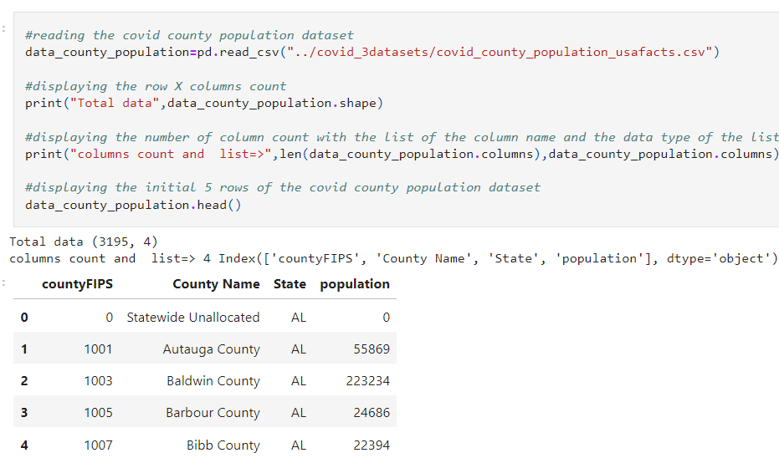
1. Read and display COVID-19 Datasets:
Imported and reviewed COVID-19 population, confirmed cases, and deaths datasets using Python’s Pandas library.

Slide 6
2. Understand the variables and its datatype in COVID-19 dataset:
1. COVID-19 County Population Dataset:
FIPS Code (County Identifier): This is a unique numeric identifier for each county. It can be represented as an integer or string depending on formatting needs. Data Type: Integer or String
County Name: The name of the county. Data Type: String
State Name/Code: The name or two-letter code of the state. Data Type: String
Population: The total population of the county. Data Type: Integer
2. COVID-19 Confirmed Cases Dataset:
FIPS Code (County Identifier): Numeric code for each county. Data Type: Integer or String
County Name: The name of the county. Data Type: String
State Name/Code: The name or two-letter code of the state. Data Type: String
Date: The date when the cases were recorded. Data Type: Date or String (Date format: YYYY-MM-DD)
Confirmed Cases: The number of confirmed COVID-19 cases. Data Type: Integer
3. COVID-19 Deaths Dataset:
FIPS Code (County Identifier): Numeric code for each county. Data Type: Integer or String
County Name: The name of the county. Data Type: String
State Name/Code: The name or two-letter code of the state. Data Type: String
Date: The date when deaths were recorded. Data Type: Date or String (Date format: YYYY-MM-DD)
Deaths: The number of COVID-19-related deaths. Data Type: Integer

Slide 7
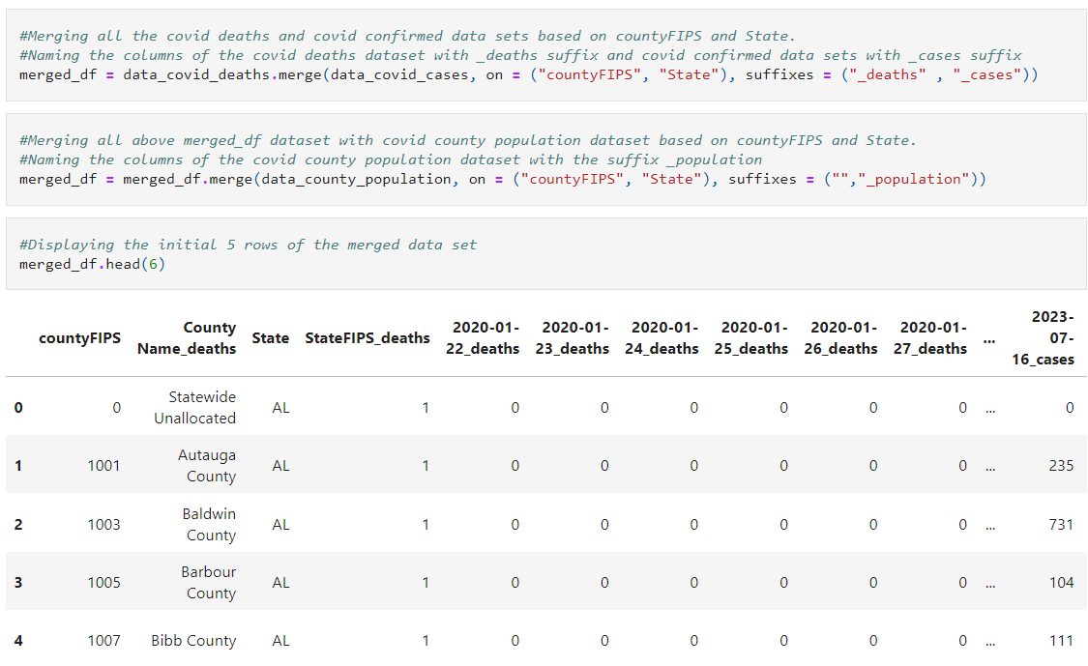
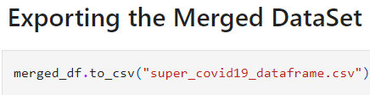
3. Merging COVID-19 dataset
After understanding the structure of the datasets, we merged them based on the FIPS code and state name. This process involved using an inner join to create a consolidated "Super COVID-19" dataframe that contains information from all three datasets.

Slide 8
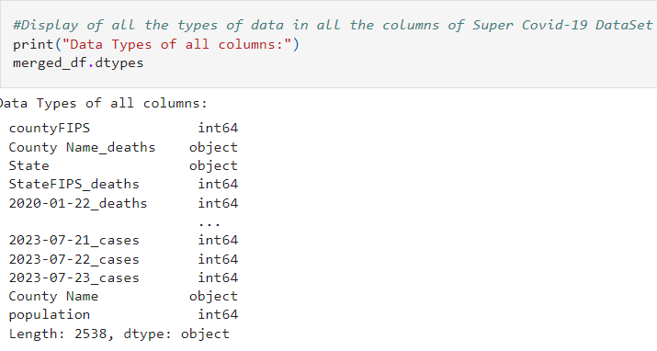
4. Final Super COVID-19 dataframe

Slide 9
Census Demographic ACS
About Dataset:
This is American Community Survey (ACS) produces population, demographic and housing unit estimates for 2020. The 2020 Census provides the official counts of the population and housing units for the counties
Source:
U.S. Census Bureau, 2016-2020 American Community Survey 5-Year Estimates
Work:
Data Cleaning
Merging the COVID-19 Data
Analyzing COVID-19 Data for 2020
COVID-19 Trends for the Last Week of 2020 (Arizona)
Enrichment Data: ACS Demographic and Housing Estimates
Cleaning ACS Data
Merging the Enriched Dataset
Enrichment Data's Role in COVID-19 Spread Analysis
Initial Hypothesis Questions

Slide 10
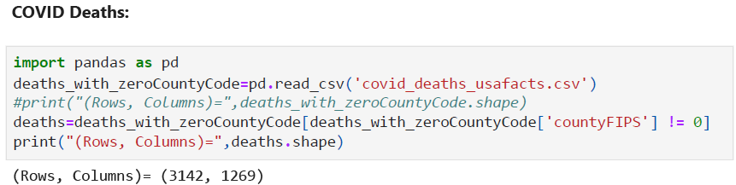
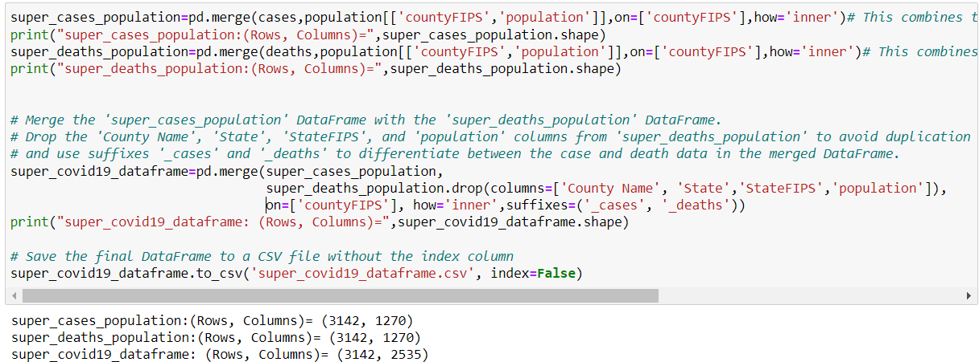
Data Cleaning
2. Merging the COVID-19 Data

Slide 11
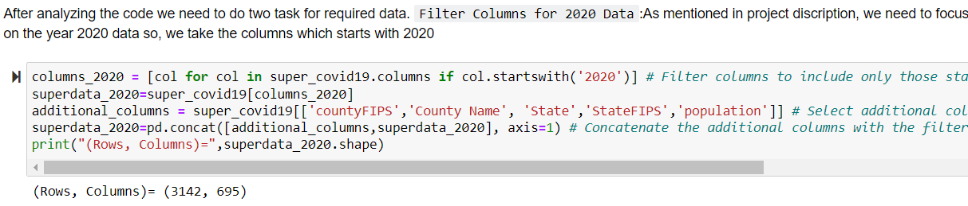
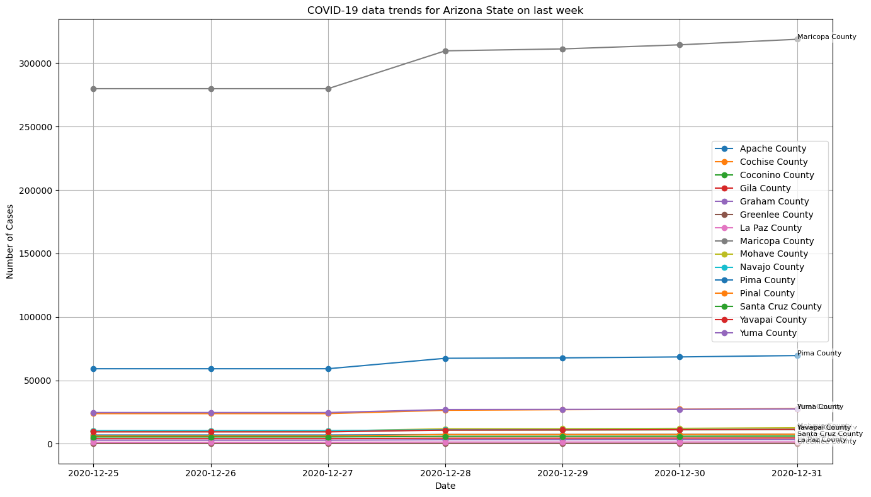
3. Analyzing COVID-19 Data for 2020
4. COVID-19 Trends for the Last Week of 2020 (Arizona)

Slide 12
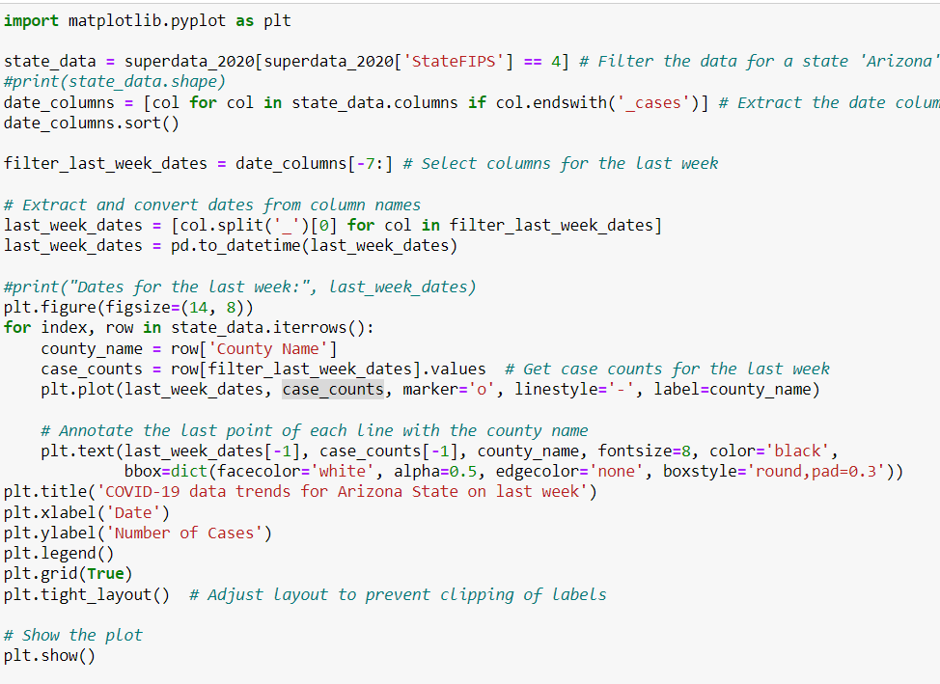
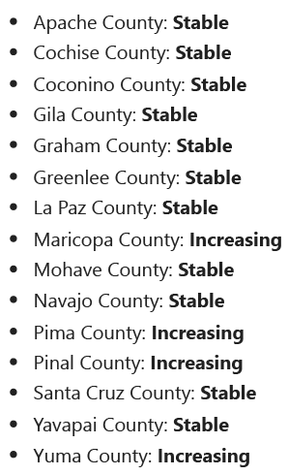

Slide 13
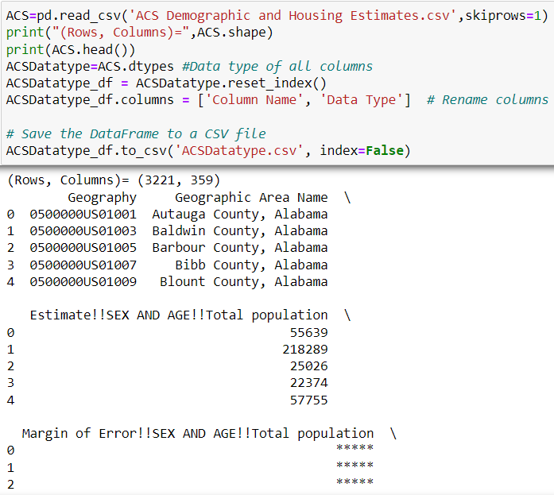
5. Enrichment Data: ACS Demographic and Housing Estimates

Slide 14
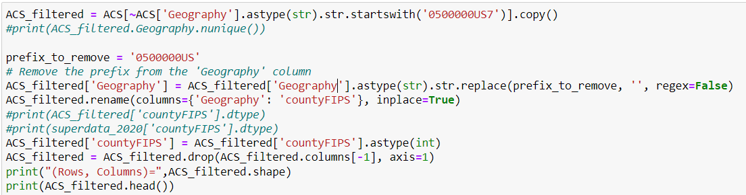
6. Cleaning ACS Data
1. Exclusion of Puerto Rico Data:
2. Remove Prefix from 'Geography' Column:
3. Rename the 'Geography' Column to 'countyFIPS' Column
4. Change Datatype of 'countyFIPS' column
5. Drop the last column wich contain NaN value

Slide 15
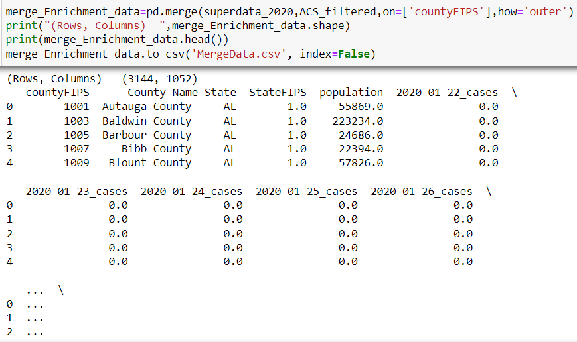
7. Merging the Enriched Dataset
After analyzing the two datasets, we perform a merge on the countyFIPS column using an outer join.
Reason for Outer Join: An outer join is used to ensure that all records from both datasets are included in the merged result. This is necessary because there are some countyFIPS codes present in the ACS_filtered dataset that are not found in the superdata_2020 dataset. Examples of such countyFIPS codes include 2063, 2066, and 2261.

Slide 16
8. Enrichment Data's Role in COVID-19 Spread Analysis
Demographic factors like population density, age distribution, and socioeconomic conditions can affect the transmission rate and mortality of COVID-19 in a region. For instance:
•Population Density and Housing: The number of housing units, particularly in relation to the population size, can provide insights into population density and crowding, both of which are factors that increase the likelihood of COVID-19 spread.
•Age Distribution: Areas with a higher elderly population might experience higher mortality rates since COVID-19 poses a greater risk to older adults.
•Sex Ratios and COVID-19: The dataset provides information about the sex ratio, which can be used to analyze if certain trends in the virus's transmission. For example, men were initially found to have a higher risk of severe outcomes from COVID-19.
9. Initial Hypothesis Questions
The enriched dataset allows us to pose several hypothesis questions for future analysis:
1. Does higher population density correlate with a higher rate of COVID-19 cases?
2. Are counties with a larger elderly population experiencing higher COVID-19 death rates?
3. Does sex ratio influence the COVID-19 death rate?

Slide 17
Enrichment Dataset - USA Presidential Elections 2020
About Dataset:
This Enrichment Data set contains detailed USA Presidential Election outcomes for the year 2020. Over 6 columns with state, county,candiate, party, total votes and won (result). The details in the data set helps to analyse the correlation between the enrichment data and the super covid19 dataset. 2020 beinga crucial year when covid-19 speard was high and presidential election was also here.
Source:
https://www.kaggle.com/unanimad/us-election-2020
Work:
Merging the datasets to create Super COVID-19 Dataframe.
Reading Enrichment Dataset and Understanding the types of variable present in it.
Reading the Super Covid 19 Dataframe and extracting data generated in the year 2020 from the super covid 19 dataframe
Merging Enrichment data set with covid-19 data focusing for the year 2020
Hypothesis to analyse correlation between the covid 19 dataset and enrichment dataset
Analysis the trend in Cases data for State North Carolina for the year 2023 and 2020 .
Analysis the trend in Death data for State North Carolina 2023 and 2020
Reading Enrichment data set and combining with super covid 19 dataframe

Slide 18
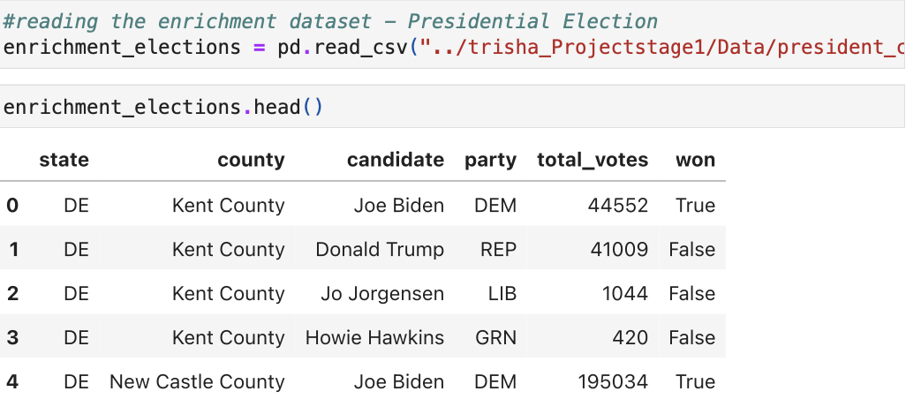
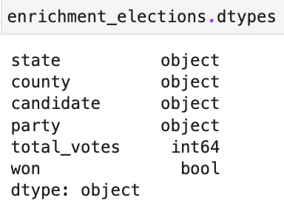
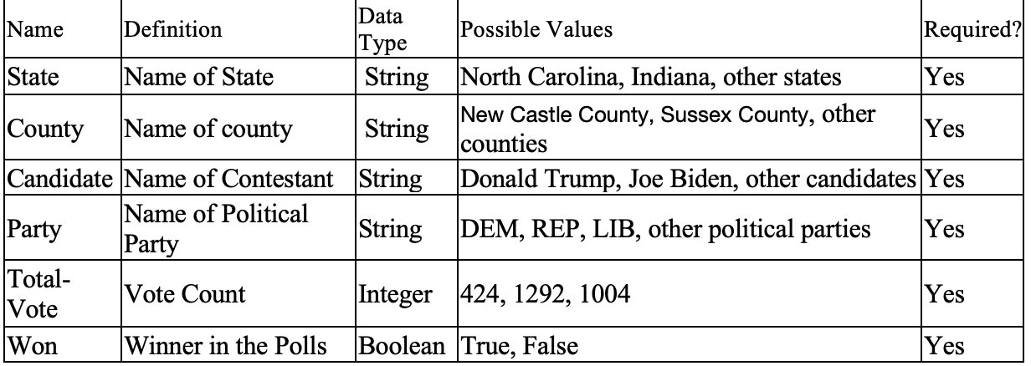
2. Reading Enrichment Dataset and Understanding the types of variable present in it.
My enrichment data set has only 3 types of vairables
Object or string ---> state, county, candidate, party,
Integer ---> total votes
Won ---> Boolean

Slide 19
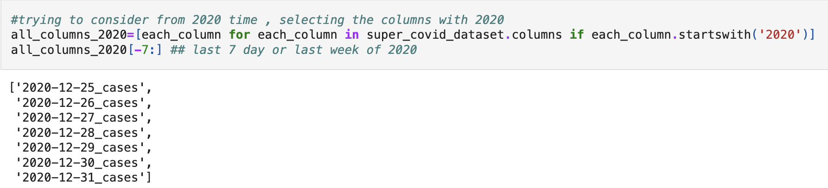
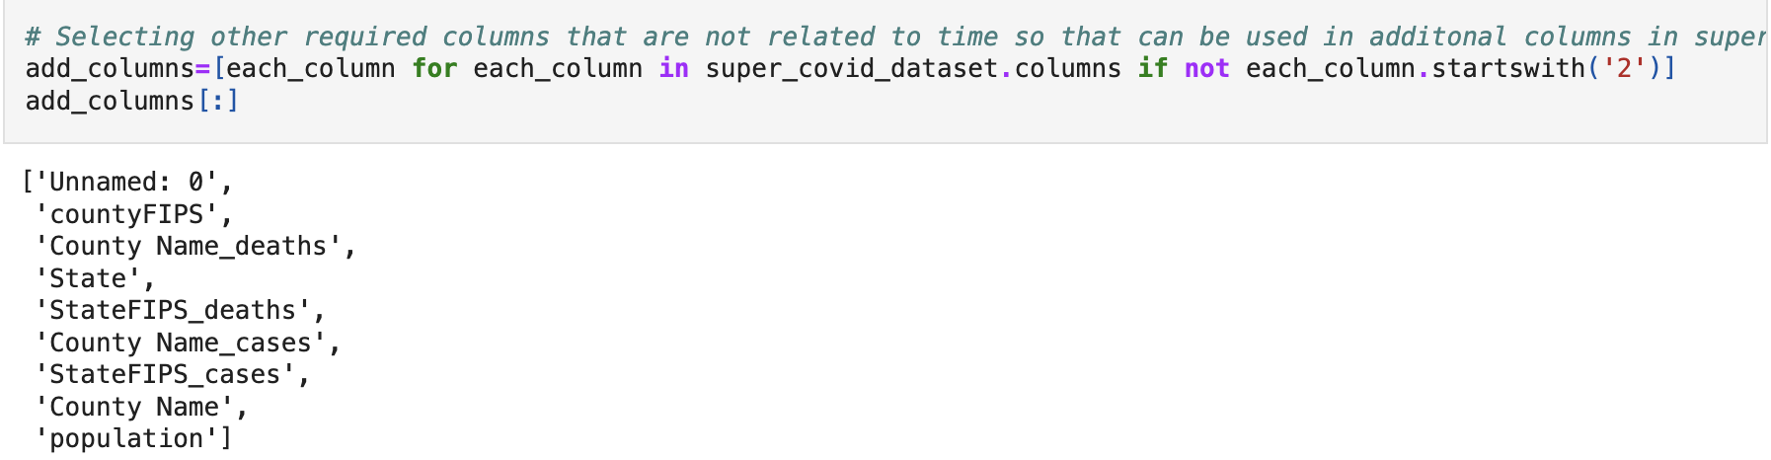
3. Reading the Super Covid 19 Dataframe and extracting data generated in the year 2020 from the super covid 19 dataframe

Slide 20
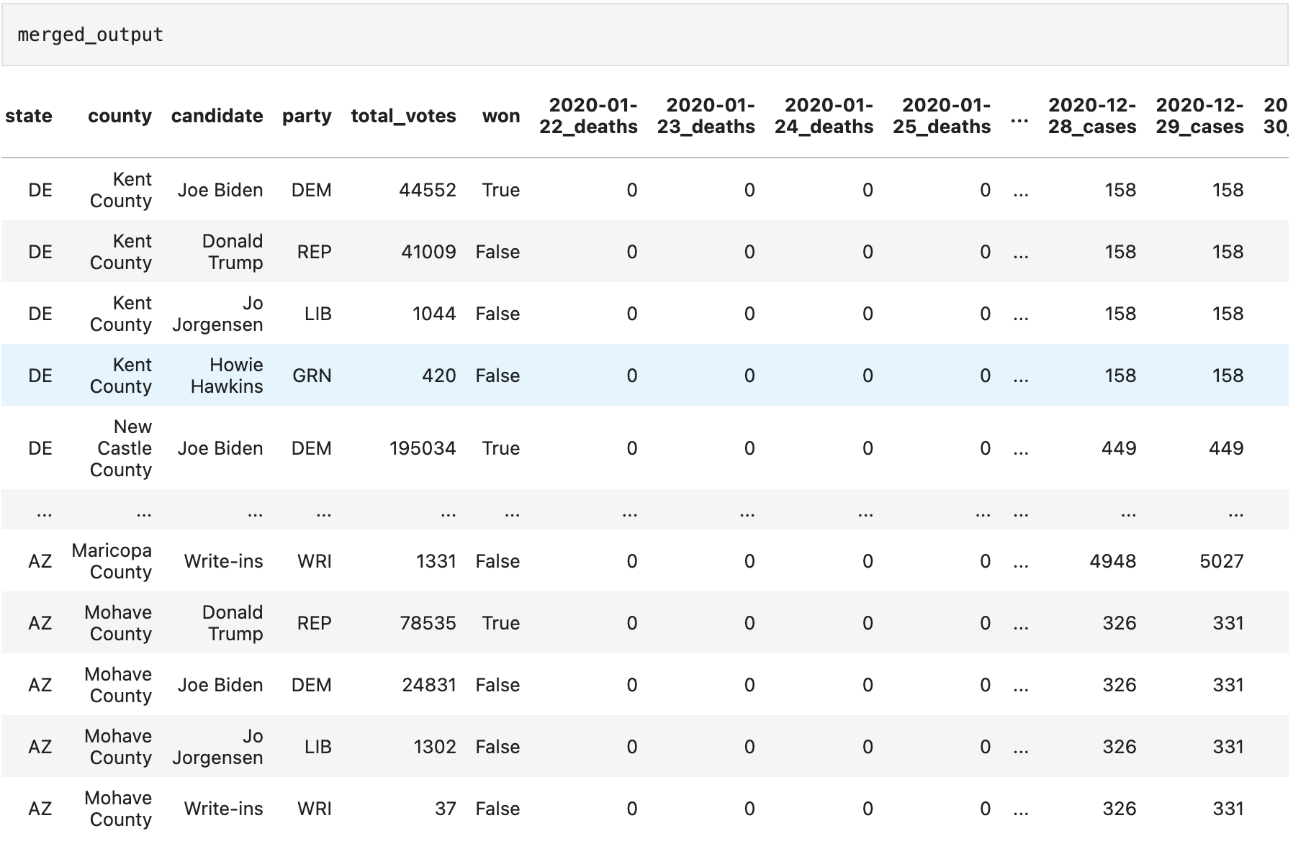
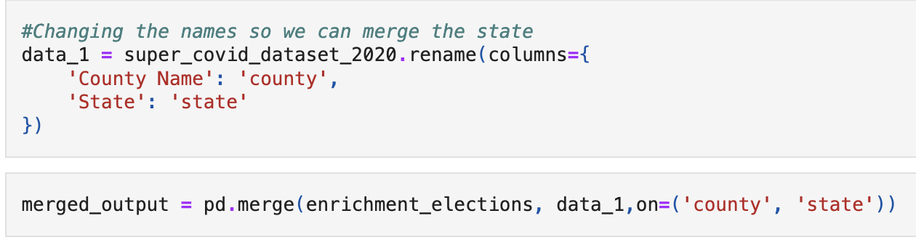
3. Merging Enrichment data set with covid-19 data focusing for the year 2020
Two common variables exist when we are trying merge our enrichment dataset and super covid 19 datasets
The variable or columns based on which we are merging our table is
o State o County
• While merging the values of rows present in both the datasets will be matched based on these 2 columns

Slide 21
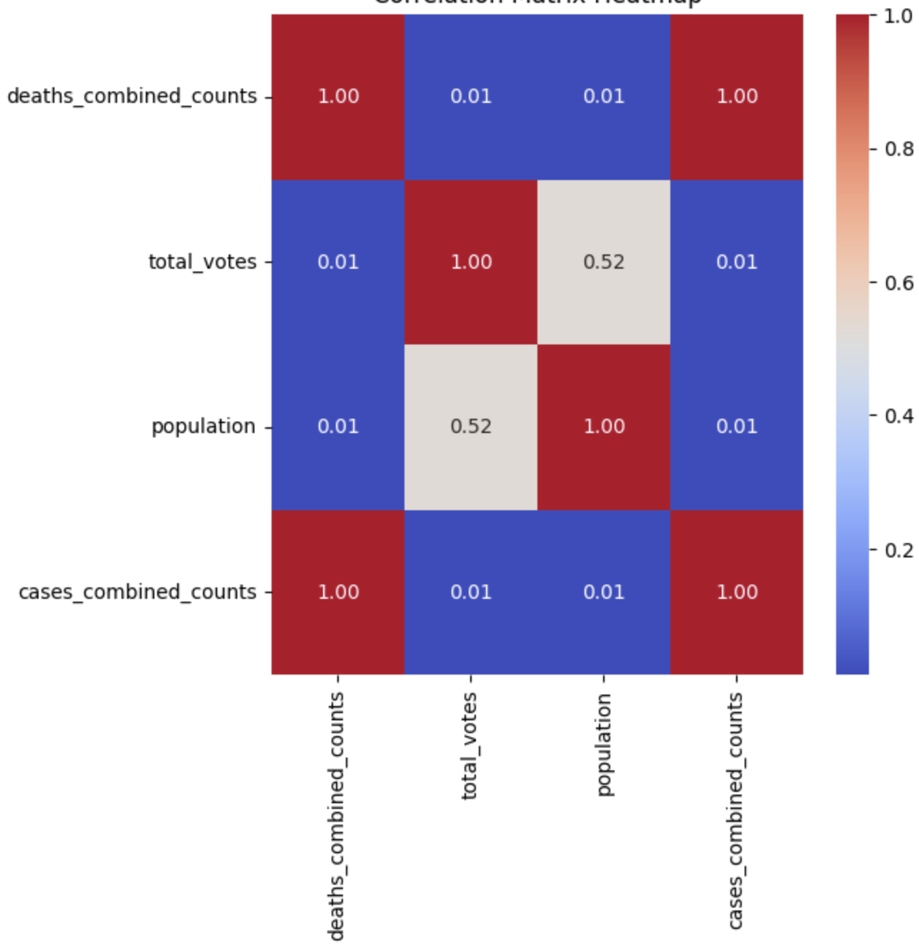
5. Hypothesis to analyse correlation between the covid 19 dataset and enrichment database
Enrichment datasets help in analysis of covid 19
The election dataset provides us insights on political leanings (e.g., Republican vs. Democratic) may have effected COVID-19 outcomes:
Like Case and Death Rates: like counties with a higher percentage of Republican or Democratic votes might have had different rates of COVID-19 cases or deaths.
Initial Hypothesis
1. We can see if any correlation exists between political affiliation and the spread of Covid-19 cases/deaths like We can see there is any correlating that the counties which favored the Republican candidate having higher COVID-19 case rates or if the Counties which favored the Democratic candidate might have had a lower COVID-19 death rate by which we can see if the covid ruled were adhered to by which group of candidates.
2. If there is any correlation between the victory of a particular candidate and the spread of the covid-19 cases/deaths
3. Also, if any correlation between total votes cast and the COVID 19 cases/deaths like higher population is, is both the votes and cases reported higher?.
I tried to see anything can be done through correlation but don’t get anything much on initial analysis will need indepth analysis
We see a relation between cases and death count but will have to perfrom more in depth analysis to see the correlation proposed in our hypothesis

Slide 22
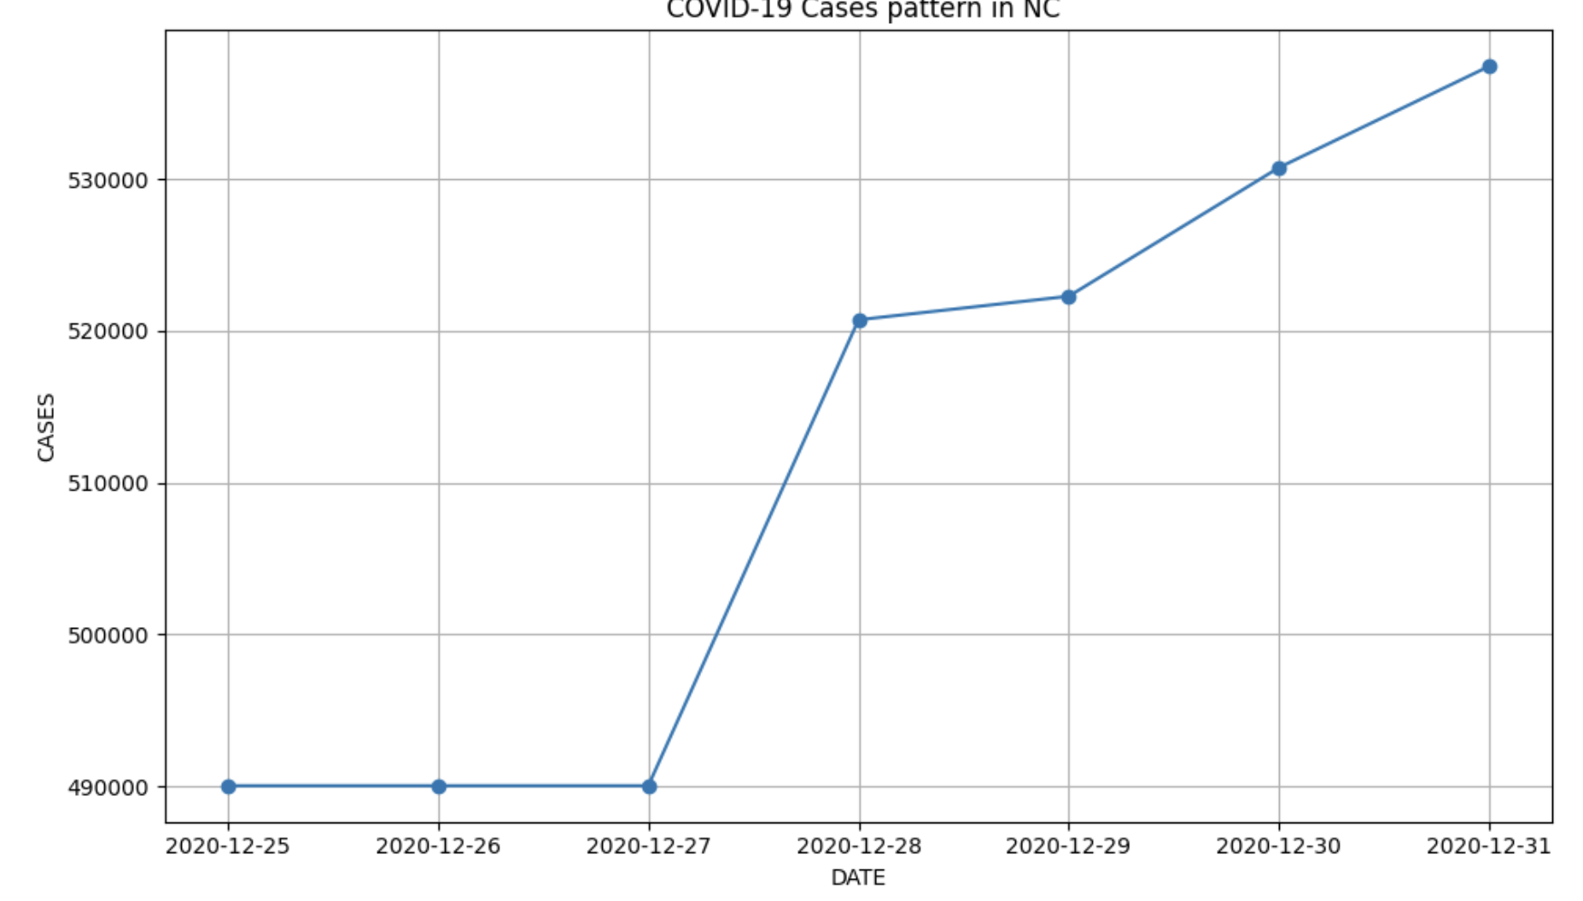
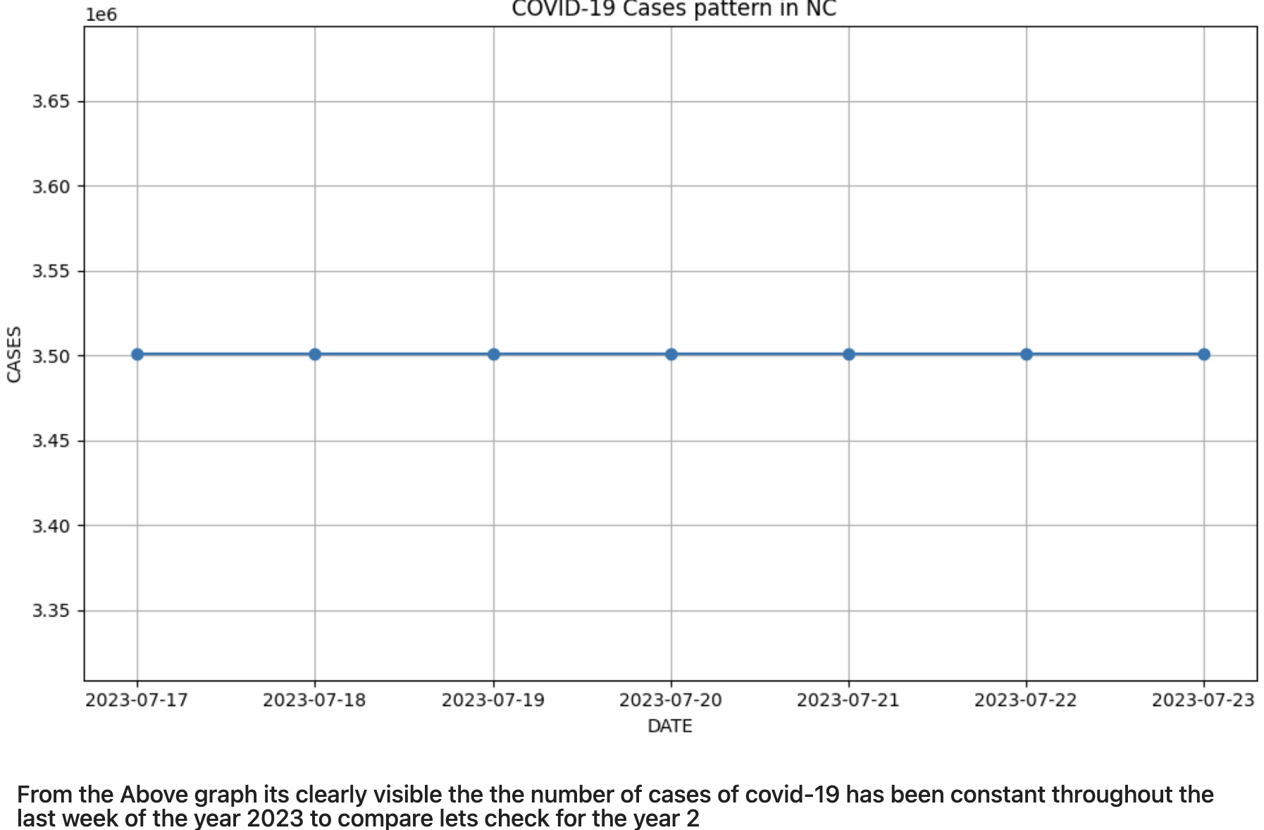
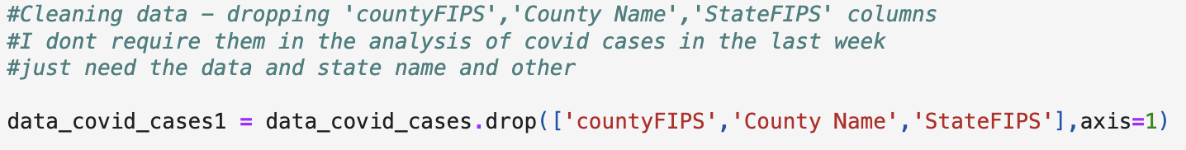
6. Analysis the trend in Cases data for State North Carolina for the year 2023 and 2020 .
Steps to plot

Slide 23
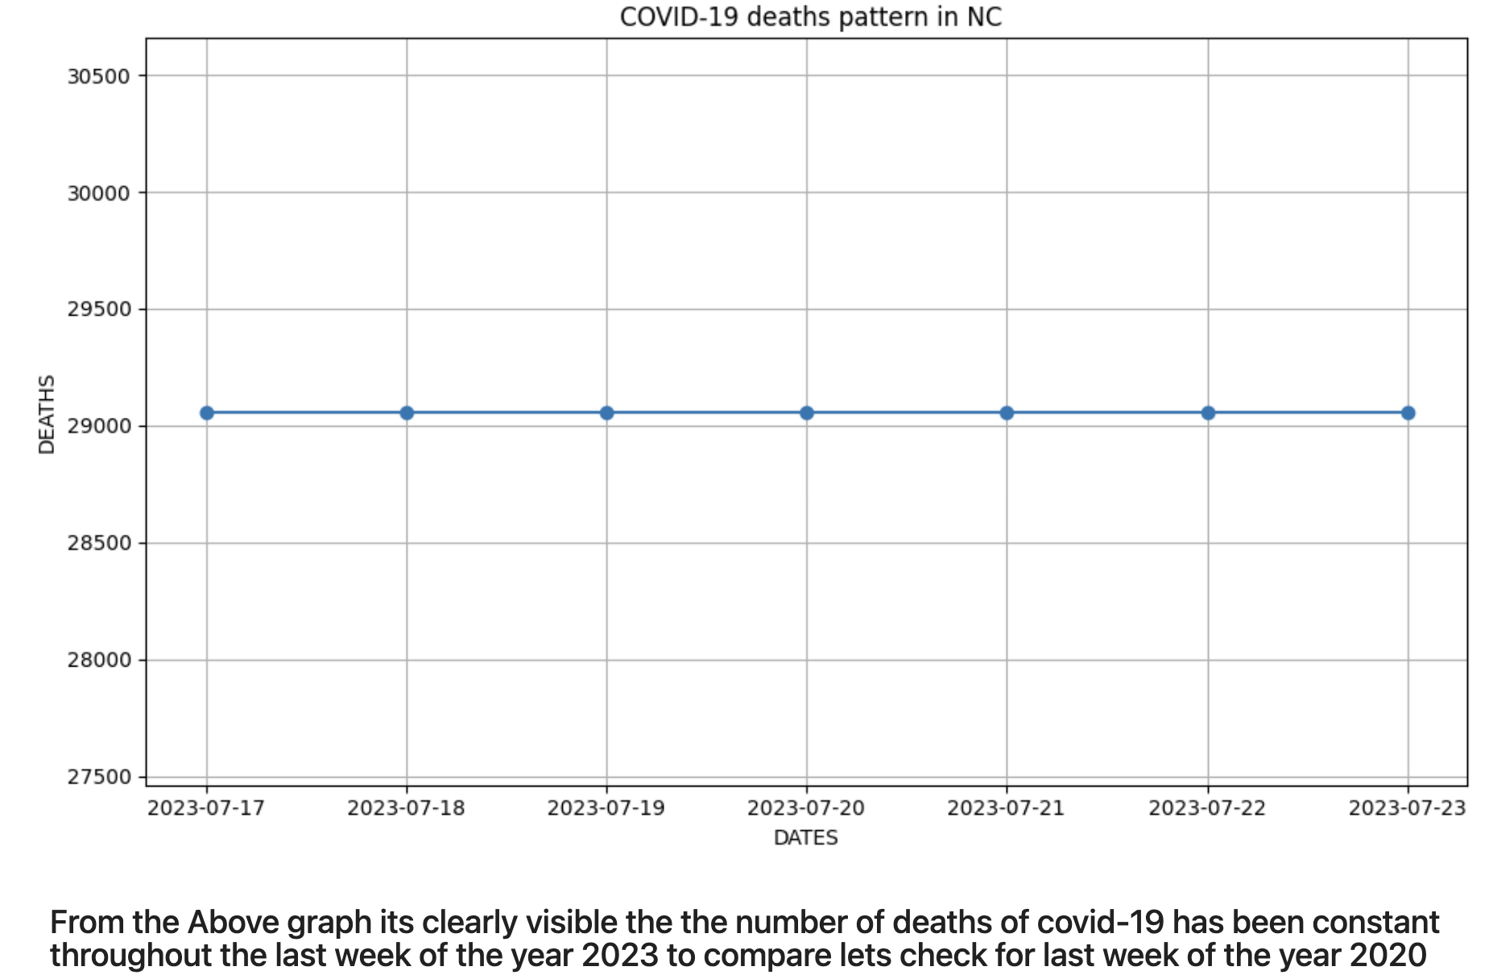
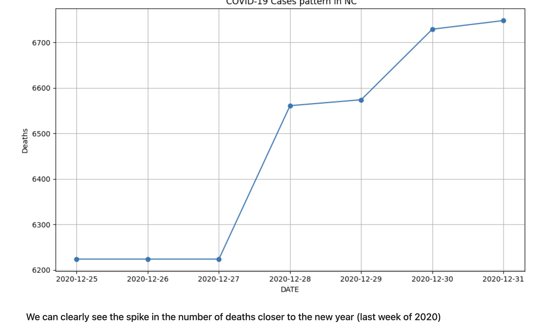
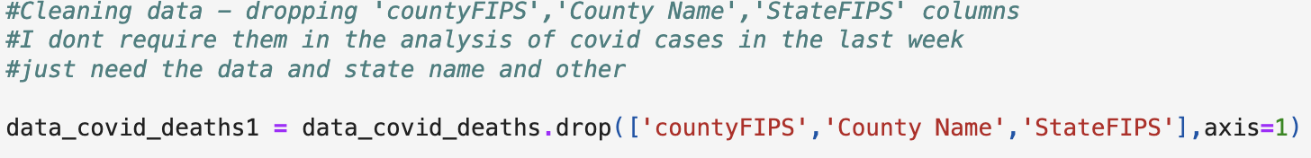
7. Analysis the trend in Death data for State North Carolina 2023 and 2020
Steps to plot

Slide 24
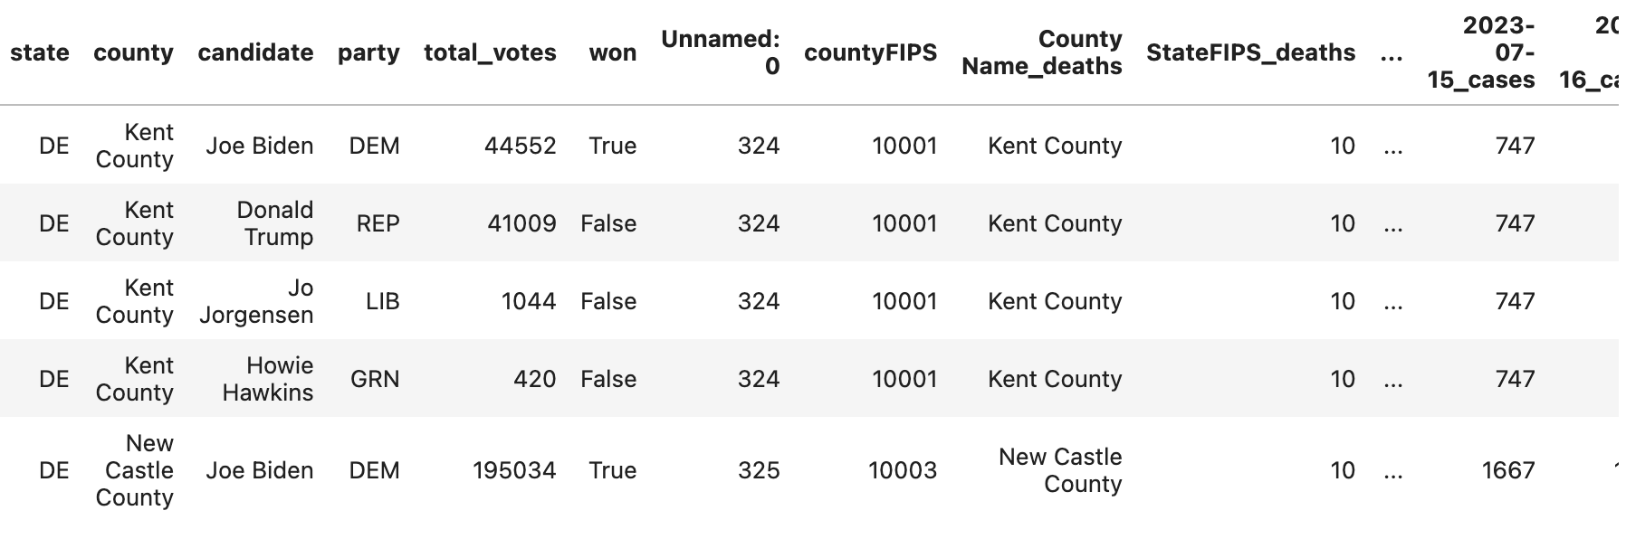
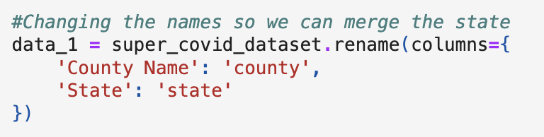
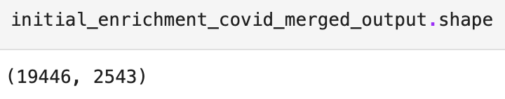
8. Reading Enrichment data set and combining with super covid 19 dataframe

Slide 25
Enrichment Data set- Employment dataset
Employment data set :
It has three data sets they are :
1.County-ests-employment-and-wages
2.State-ests-employment-and-wages
3.Top-ten-ests-employment-and-wages

Slide 26
Steps followed :
Step 1:
1.Understanding the above data set
2.Reading the data set
3. Printing first five rows of dataset
Step 2:
1. Printing the variable dictionary to understand the variables present in each column.
Step 3:
Filtering the data with year 2020.

Slide 27
Step 4:
Merging Covid 19 data set with our Enrichment dataset which is filtered for the year 2020.
Step 5:
Saving the final merge dataset as .csv file
Step 6:
Initial Hypothesis Questions
Step 7:
Selecting the state
Filtering the data for NY
Step 8:
Identifying the last week trend for specified state that we have selected .

Slide 28
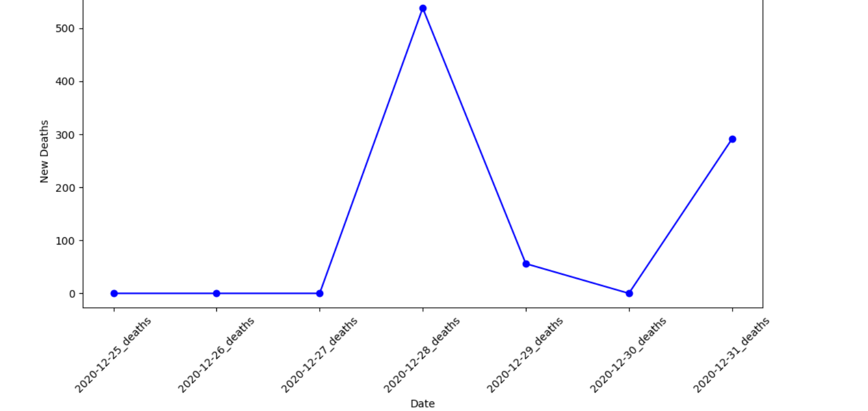

Slide 29
Initial Hypothesis Questions
## How did the emplyoment sector got effected due to Covid19?
## Did the employment rates is effected in essential sectors like health care,regualr services during the pandemic?
## Did you think the areas with higher employment faced more COVID-19 cases than the areas with lower employment?
## What is the major factor that effect employment?
## Is major cities faced more number of covid cases due to employment ,how expain?
## Does employment rate effect the economy of the county?

Slide 30
Analyzing COVID-19 Data with ACS Social, Economic, and Housing
Housing Data Source:
Housing Dataset: Contains various housing metrics for each county, such as median housing prices, total sales, and housing units. This dataset provides insights into the economic and social landscape of each county.
Source:
. Data Merging Process:
Step 1: Merging COVID-19 Datasets
The first step involved merging the three COVID-19 datasets using the countyFIPS column, a unique identifier for each county in the US.
Process:
Common Key: The county_fips column was used as the key for merging.
Datasets Merged: COVID-19 cases, deaths, and population data were merged using the merge() function in pandas.
Step 2: Merging COVID-19 Data with Housing Data:
The merged COVID-19 dataset was then combined with the housing dataset, also using county_fips as the key. This allowed us to enrich the COVID-19 data with socioeconomic factors such as median housing price and total housing sales.

Slide 31
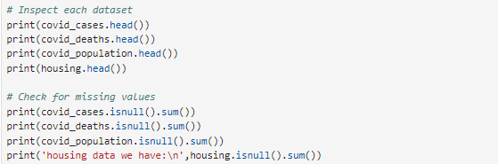
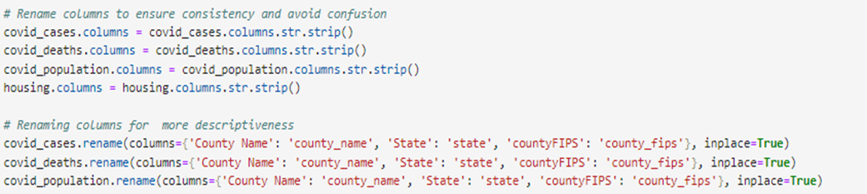
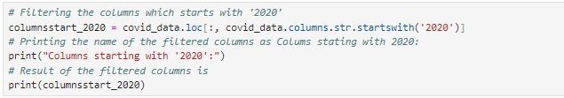

Slide 32
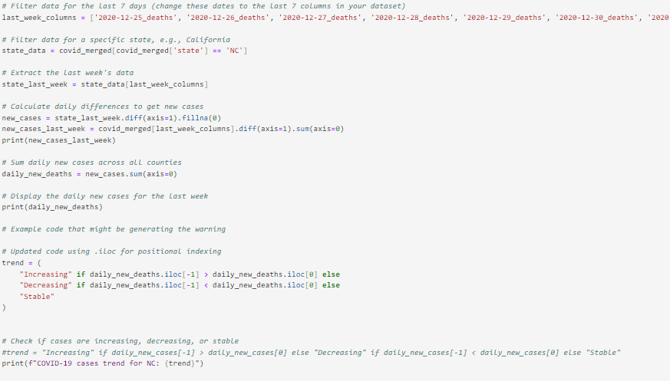

Slide 33
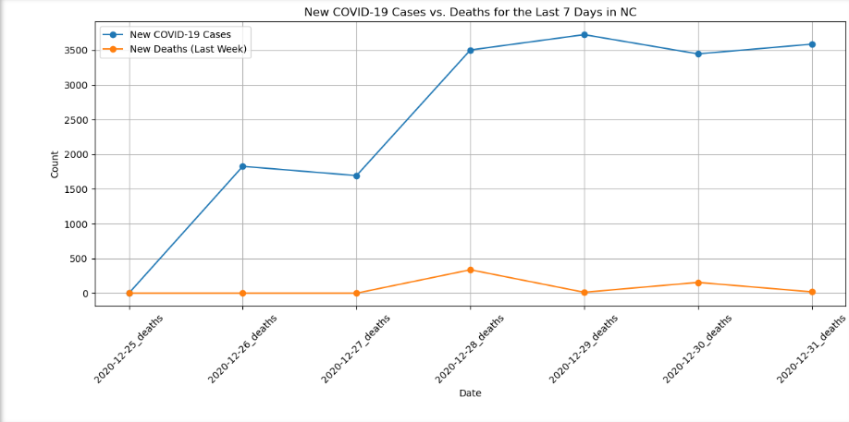
Hypothesis:
What are the trends in COVID-19 cases over time?
Study the relationship between housing characteristics (e.g., prices, sales) and COVID-19 cases and deaths?
Pose and test hypotheses about how socioeconomic factors might influence the spread of the pandemic ?

